Slide 1
Substation and Distribution Automation
Module 3: Distribution level power flow

Slide 2
Module 3 Overview
Part 1 - Review of balanced power flow
Part 2 - Forward Backward Sweep (FBS) method
Part 3 - Three Phase Current Injection (TCIM) Newton Raphson (NR) method

Slide 3
Part 1 - Review of balanced power flow
Review of balanced power flow
Gauss Iterative Technique
Gauss-Seidel Iterative Technique
Newton Raphson
Fast Decoupled
DC Power Flow

Slide 4
Review of balanced power flow
Fig. 1 Four bus system: One-line diagram
The net complex power injected into the bus is given by:
$S_{i,sch}=P_{i,sch}+{jQ}_{i,sch}=\left(P_{Gi}−P_{Di}\right)+j\left(Q_{Gi}−Q_{Di}\right)$ (1)
where complex power supplied by the generator is:
$S_{Gi}=P_{Gi}+{jQ}_{Gi}$ (2)
and the complex power drawn by the loads is:
$S_{Di}=P_{Di}+{jQ}_{Di}$ (3)

Slide 5
Review of balanced power flow
Fig. 3 Equivalent power system circuit
Fig. 4 Power network of Fig. 3 lumped and redrawn

Slide 6

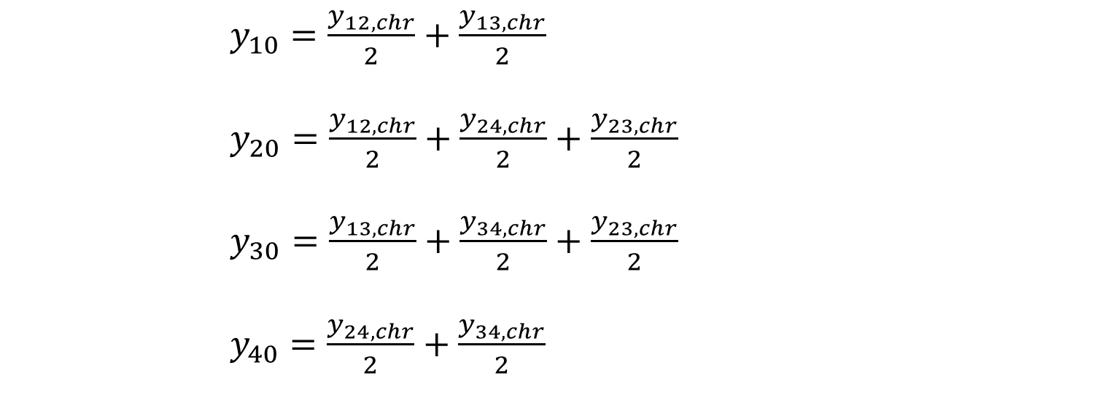
Review of balanced power flow
The real and reactive powers injected into the $i$th bus are then:
$P_{i,sch}=P_{Gi}−P_{Di} i=1,2,…,n$
$Q_{i,sch}=Q_{Gi}−Q_{Di}$
(4)
The network model of Fig. 3 has been redrawn in Fig. 4 after lumping the shunt admittances at the buses.
$y_{10}=\frac{y_{12,chr}}{2}+\frac{y_{13,chr}}{2}$
$y_{20}=\frac{y_{12,chr}}{2}+\frac{y_{24,chr}}{2}+\frac{y_{23,chr}}{2}$
$y_{30}=\frac{y_{13,chr}}{2}+\frac{y_{34,chr}}{2}+\frac{y_{23,chr}}{2}$
$y_{40}=\frac{y_{24,chr}}{2}+\frac{y_{34,chr}}{2}$
(5)

Slide 7
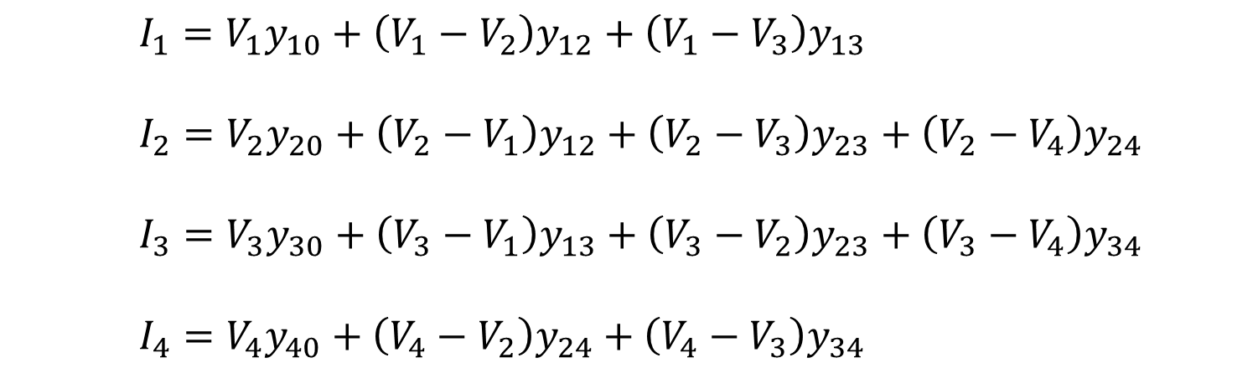
Review of balanced power flow
Besides the ground node, there are four other nodes (buses) at which the current from the sources is injected into the network.
Apply Kirchhoff’s current law (KCL) at nodes 1,2,3 and 4, respectively, to get the following four equations:
$I_{1}=V_{1}y_{10}+\left(V_{1}−V_{2}\right)y_{12}+\left(V_{1}−V_{3}\right)y_{13}$
$I_{2}=V_{2}y_{20}+\left(V_{2}−V_{1}\right)y_{12}+\left(V_{2}−V_{3}\right)y_{23}+\left(V_{2}−V_{4}\right)y_{24}$
$I_{3}=V_{3}y_{30}+\left(V_{3}−V_{1}\right)y_{13}+\left(V_{3}−V_{2}\right)y_{23}+\left(V_{3}−V_{4}\right)y_{34}$
$I_{4}=V_{4}y_{40}+\left(V_{4}−V_{2}\right)y_{24}+\left(V_{4}−V_{3}\right)y_{34}$
(6)

Slide 8
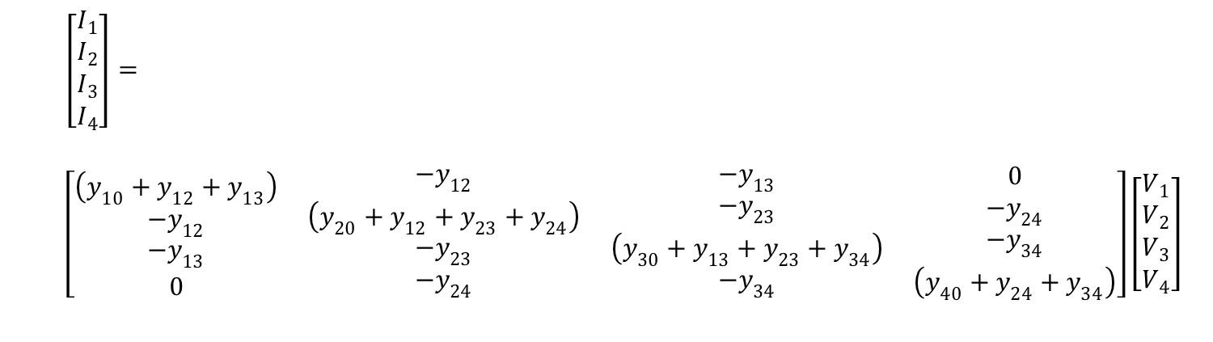
Review of balanced power flow
Rearranging and writing in matrix form gives:
$\left[\begin{matrix}I_{1} \\ I_{2} \\ \begin{matrix}I_{3} \\ I_{4}\end{matrix}\end{matrix}\right]=$
$\left[\begin{matrix}\left(y_{10}+y_{12}+y_{13}\right) \\ {−y}_{12} \\ \begin{matrix}{−y}_{13} \\ 0\end{matrix}\end{matrix} \begin{matrix}{−y}_{12} \\ \left(y_{20}+y_{12}+y_{23}+y_{24}\right) \\ \begin{matrix}{−y}_{23} \\ {−y}_{24}\end{matrix}\end{matrix} \begin{matrix}{−y}_{13} \\ {−y}_{23} \\ \begin{matrix}\left(y_{30}+y_{13}+y_{23}+y_{34}\right) \\ {−y}_{34}\end{matrix}\end{matrix} \begin{matrix}0 \\ {−y}_{24} \\ \begin{matrix}{−y}_{34} \\ \left(y_{40}+y_{24}+y_{34}\right)\end{matrix}\end{matrix}\right]\left[\begin{matrix}V_{1} \\ V_{2} \\ \begin{matrix}V_{3} \\ V_{4}\end{matrix}\end{matrix}\right]$
(7)

Slide 9
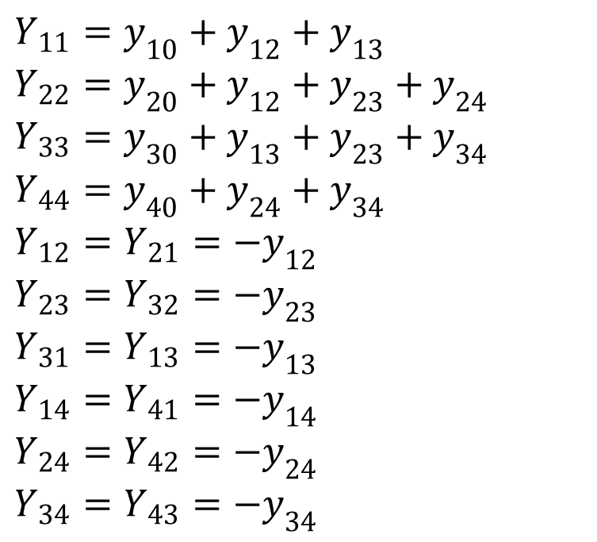
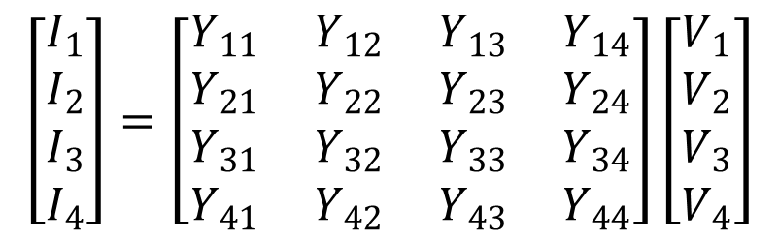
(7)
Above equation (7) can be recognized to be of the standard form:
$Y_{11}=y_{10}+y_{12}+y_{13}$
$Y_{22}=y_{20}+y_{12}+y_{23}+y_{24}$
$Y_{33}=y_{30}+y_{13}+y_{23}+y_{34}$
$Y_{44}=y_{40}+y_{24}+y_{34}$
$Y_{12}=Y_{21}=−y_{12}$
$Y_{23}=Y_{32}=−y_{23}$
$Y_{31}=Y_{13}=−y_{13}$
$Y_{14}=Y_{41}=−y_{14}$
$Y_{24}=Y_{42}=−y_{24}$
$Y_{34}=Y_{43}=−y_{34}$
$$\left[\begin{matrix}I_{1} \\ I_{2} \\ \begin{matrix}I_{3} \\ I_{4}\end{matrix}\end{matrix}\right]=\left[\begin{matrix}Y_{11} \\ Y_{21} \\ \begin{matrix}Y_{31} \\ Y_{41}\end{matrix}\end{matrix} \begin{matrix}Y_{12} \\ Y_{22} \\ \begin{matrix}Y_{32} \\ Y_{42}\end{matrix}\end{matrix} \begin{matrix}Y_{13} \\ Y_{23} \\ \begin{matrix}Y_{33} \\ Y_{43}\end{matrix}\end{matrix} \begin{matrix}Y_{14} \\ Y_{24} \\ \begin{matrix}Y_{34} \\ Y_{44}\end{matrix}\end{matrix}\right]\left[\begin{matrix}V_{1} \\ V_{2} \\ \begin{matrix}V_{3} \\ V_{4}\end{matrix}\end{matrix}\right]$$
(8)

Slide 10
Review of balanced power flow
Each admittance Y_{ii} (i = 1,2,3,4) is called the self admittance (or driving point admittance) of node i and equals the algebraic sum of all the admittances terminating on the node.
Each off-diagonal term Y_{ik} (I, k = 1,2,3,4) is the mutual admittance (transfer admittance) between nodes i and k and equals the negative of the sum of all admittances connected directly between these nodes.
Further, Y_{ik} = Y_{ki}
Figure 4

Slide 11
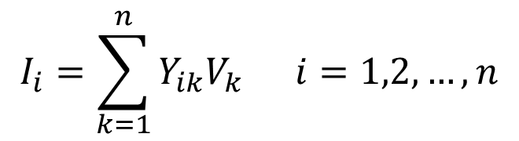
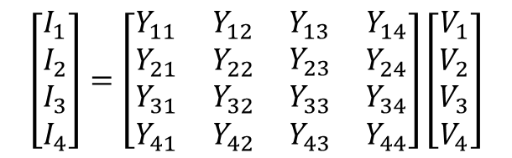
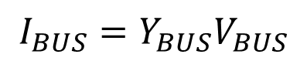
Review of balanced power flow
$$\left[\begin{matrix}I_{1} \\ I_{2} \\ \begin{matrix}I_{3} \\ I_{4}\end{matrix}\end{matrix}\right]=\left[\begin{matrix}Y_{11} \\ Y_{21} \\ \begin{matrix}Y_{31} \\ Y_{41}\end{matrix}\end{matrix} \begin{matrix}Y_{12} \\ Y_{22} \\ \begin{matrix}Y_{32} \\ Y_{42}\end{matrix}\end{matrix} \begin{matrix}Y_{13} \\ Y_{23} \\ \begin{matrix}Y_{33} \\ Y_{43}\end{matrix}\end{matrix} \begin{matrix}Y_{14} \\ Y_{24} \\ \begin{matrix}Y_{34} \\ Y_{44}\end{matrix}\end{matrix}\right]\left[\begin{matrix}V_{1} \\ V_{2} \\ \begin{matrix}V_{3} \\ V_{4}\end{matrix}\end{matrix}\right]$$
(8)
From index notation, Eq. (8) can be written in compact form as:
$$I_{i}=\sum_{k=1}^{n}{Y_{ik}V_{k}} i=1,2,…,n$$
(9)
or, in matrix form:
$$I_{BUS}=Y_{BUS}V_{BUS}$$
(10)
where Y_{BUS} denotes the matrix of bus admittance and is known as bus admittance matrix.
The dimension of the Y_{BUS} matrix is (n × n) where n is the number of buses.
The total number of nodes are m = n + 1 including the ground (reference) node.

Slide 12
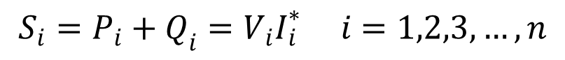
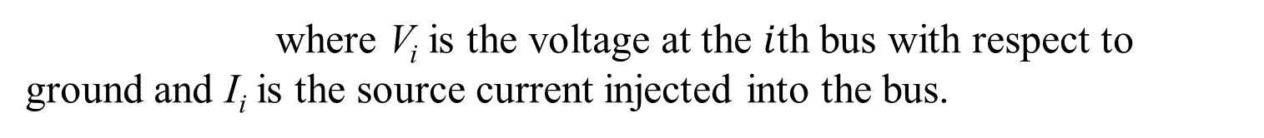
Review of balanced power flow
Load Flow Problem:
The complex power injected by the source into the ith bus of a power system is:
$$S_{i}=P_{i}+Q_{i}=V_{i}I_{i}^{∗} i=1,2,3,…,n$$
(11)
where V_{i} is the voltage at the $i$th bus with respect to ground and I_{i} is the source current injected into the bus.
The load flow problem is handled more conveniently by use of I_{i} rather than I_{i}*.

Slide 13
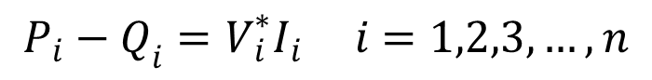
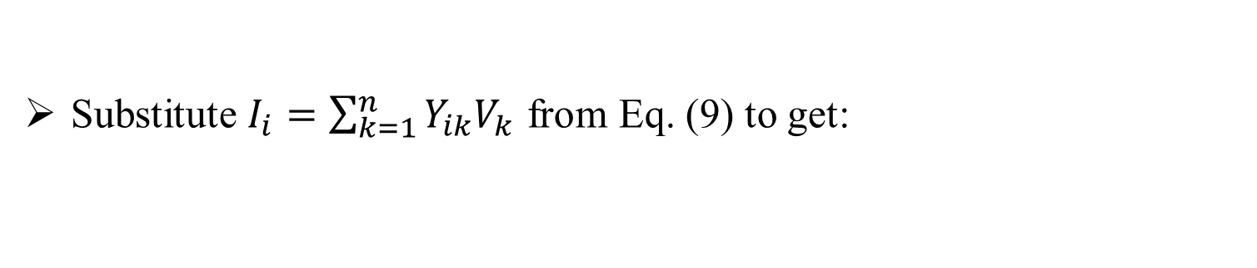
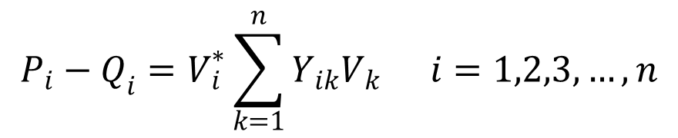
Review of balanced power flow
Therefore, taking the complex conjugate of Eq. (11) gives:
$$P_{i}−Q_{i}=V_{i}^{∗}I_{i} i=1,2,3,…,n$$
(12)
Substitute $I_{i}=\sum_{k=1}^{n}{Y_{ik}V_{k}}$ from Eq. (9) to get:
$$P_{i}−Q_{i}=V_{i}^{∗}\sum_{k=1}^{n}{Y_{ik}V_{k}} i=1,2,3,…,n$$
(13)

Slide 14

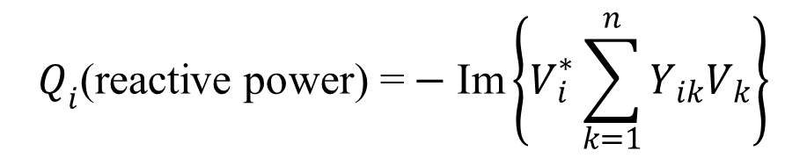
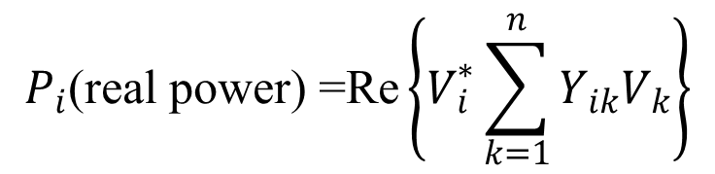
Review of balanced power flow
Equating real and imaginary parts:
$$P_{i}\text{(}\text{real} \text{power}\text{) =}\text{Re}\left\{V_{i}^{∗}\sum_{k=1}^{n}{Y_{ik}V_{k}}\right\}$$
(14)
$$Q_{i}\text{(}\text{reactive} \text{power}\text{) =}−\text{Im}\left\{V_{i}^{∗}\sum_{k=1}^{n}{Y_{ik}V_{k}}\right\}$$
(15)
In polar form:
$V_{i}=\left|V_{i}\right|e^{jδ_{i}}$
$Y_{ik}=\left|Y_{ik}\right|e^{{jθ}_{ik}}$
(16)

Slide 15
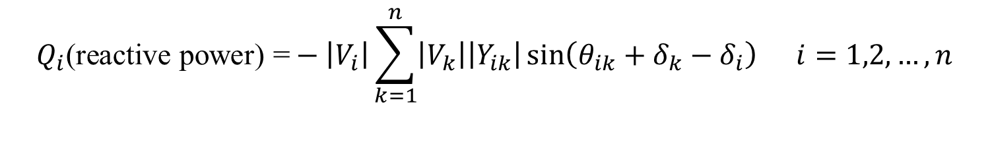
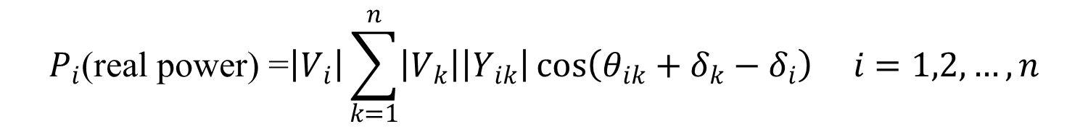
Review of balanced power flow
Real and reactive powers can now be expressed as:
$$P_{i}\text{(}\text{real} \text{power}\text{) =}\left|V_{i}\right|\sum_{k=1}^{n}{\left|V_{k}\right|\left|Y_{ik}\right|}\cos\left(θ_{ik}+δ_{k}−δ_{i}\right) i=1,2,…,n$$
(17)
$$Q_{i}\text{(}\text{reactive} \text{power}\text{) =}−\left|V_{i}\right|\sum_{k=1}^{n}{\left|V_{k}\right|\left|Y_{ik}\right|}\sin\left(θ_{ik}+δ_{k}−δ_{i}\right){ i=1,2,…,n}$$
(18)

Slide 16
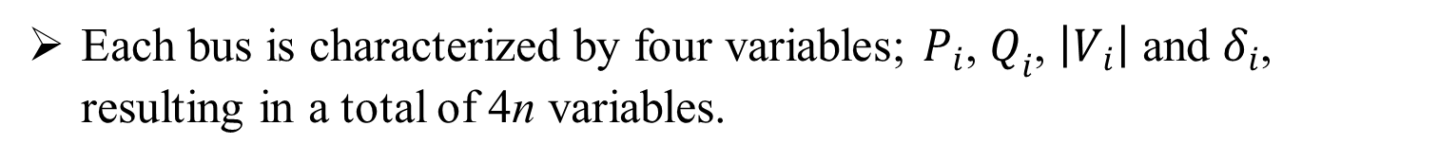
Review of balanced power flow
Power flow equations
P_{i} (real power) =
(17)
Q_{i} (reactive power) =
(18)
Equations (17) and (18) represent 2n power flow equations at n buses of a power system (n real power flow equations and n reactive power flow equations).
Each bus is characterized by four variables; $P_{i}$, $Q_{i}$, $\left|V_{i}\right|$ and $δ_{i}$, resulting in a total of 4n variables.
Equations (17) and (18) can be solved for 2n variables if the remaining 2n variables are specified.

Slide 17
Review of balanced power flow
Power flow equations (continued)
Practical considerations allow a power system analyst to fix a priori two variables at each bus.
The solution for the remaining 2n bus variables is obtained by iterative numerical techniques.
Depending upon which two variables are specified, the buses are classified into three categories – PQ Buses (Load Buses), PV Buses (Generator Buses), Slack or Reference Bus.
Slack bus (ref. bus) - Voltage magnitude and angle known - $\left|V_{1}\right|$, $δ_{\begin{aligned}1 \\ \end{aligned}}$
PV Bus : real power and voltage magnitude known - $P_{i}$, $\left|V_{i}\right|$
PQ Bus : real and reactive powers known - $P_{i}$, $Q_{i}$

Slide 18
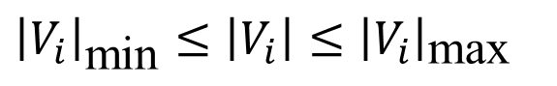
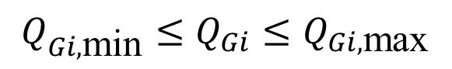
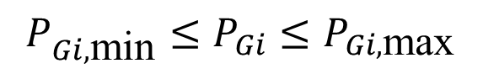
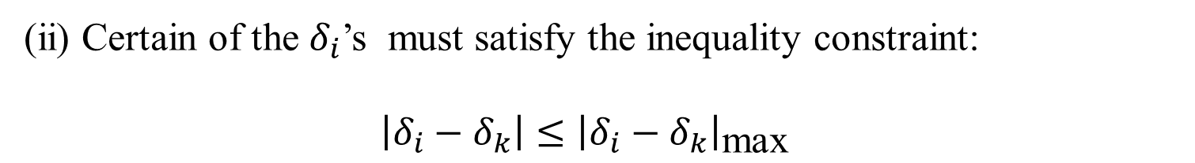
Review of balanced power flow
When we solve the power flow problem, all the variables must lie within practical limits.
Voltage magnitude $\left|V_{i}\right|$ must satisfy the inequality:
${\left|V_{i}\right|}_{\text{min}}≤\left|V_{i}\right|≤{\left|V_{i}\right|}_{\text{max}}$
(19)
(ii) Certain of the $δ_{i}$’s must satisfy the inequality constraint:
$\left|δ_{i}−δ_{k}\right|≤{\left|δ_{i}−δ_{k}\right|}_{\text{max}}$
(20)
(iii) Because of physical limitations on the generators, P_{Gi} and Q_{Gi} are
constrained as follows:
$$P_{Gi, \text{min}}≤P_{Gi}≤P_{Gi, \text{max}}$$
(21)
$$Q_{Gi, \text{min}}≤Q_{Gi}≤Q_{Gi, \text{max}}$$
(22)

Slide 19
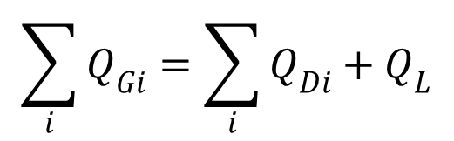
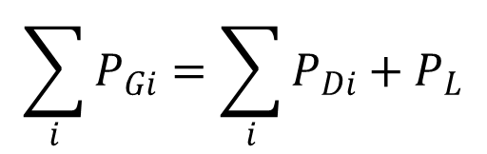
Review of balanced power flow
The total generation of real and reactive power must equal the total load demand plus losses, i.e.
$$\sum_{i}{P_{Gi}}=\sum_{i}{P_{Di}+P_{L}}$$
(23)
$$\sum_{i}{Q_{Gi}}=\sum_{i}{Q_{Di}+Q_{L}}$$
(24)
where P_{L} and Q_{L} are system real and reactive power loss, respectively

Slide 20
Part 1 - Review of balanced power flow
Review of balanced power flow
Gauss Iterative Technique
Gauss-Seidel Iterative Technique
Newton Raphson
Fast Decoupled
DC Power Flow

Slide 21
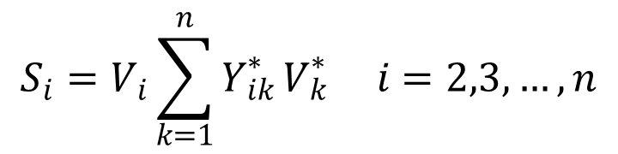
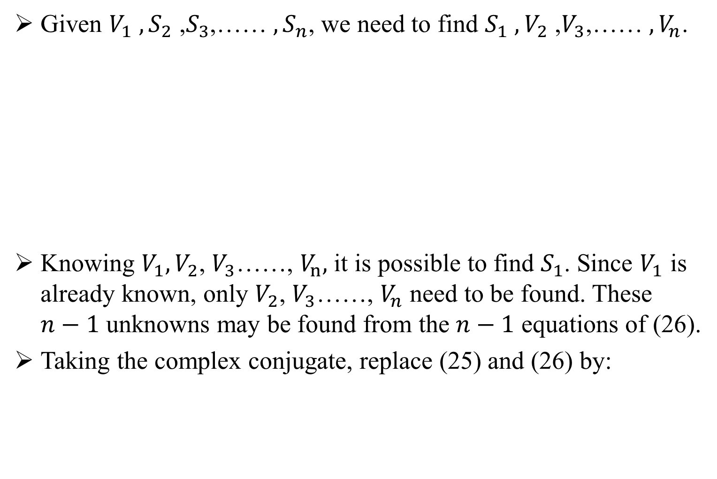
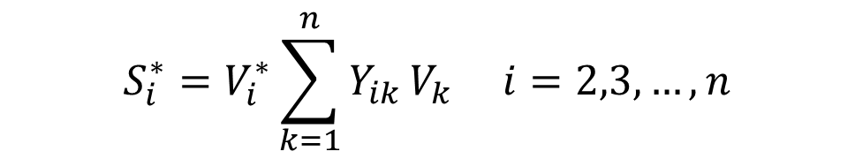
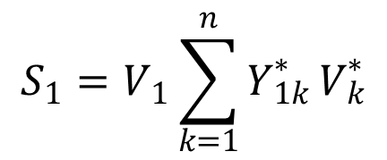
Gauss Iterative Technique
Given $V_{1}$ ${, S}_{2}$ ,$S_{3}$,…… ${, S}_{n}$, we need to find $S_{1}$ ${,V}_{2}$ ,$V_{3}$,…… ${, V}_{n}$.
Knowing $V_{1},V_{2}$, $V_{3}$……, $V_{n},$ it is possible to find $S_{1}$. Since $V_{1}$ is already known, only $V_{2}$, $V_{3}$……, $V_{n}$ need to be found. These $n−1$ unknowns may be found from the $n−1$ equations of (26).
Taking the complex conjugate, replace (25) and (26) by:
$$S_{1}=V_{1}\sum_{k=1}^{n}{Y_{1k}^{∗}}V_{k}^{∗}$$
(25)
$$S_{i}=V_{i}\sum_{k=1}^{n}{Y_{ik}^{∗}}V_{k}^{∗} i=2,3,…,n$$
(26)
$$S_{i}^{∗}=V_{i}^{∗}\sum_{k=1}^{n}{Y_{ik}}V_{k} i=2,3,…,n$$
(27)

Slide 22
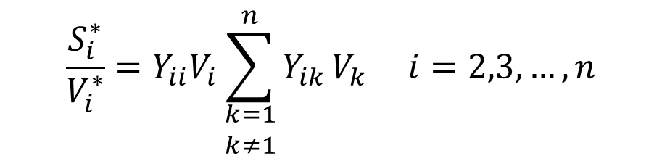
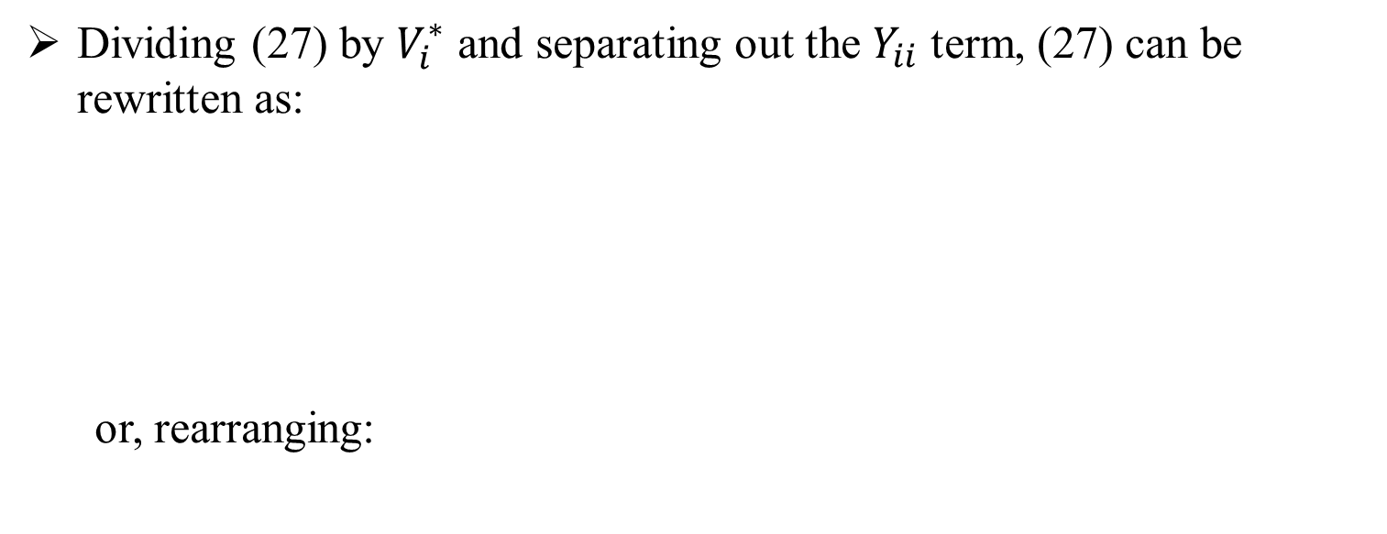
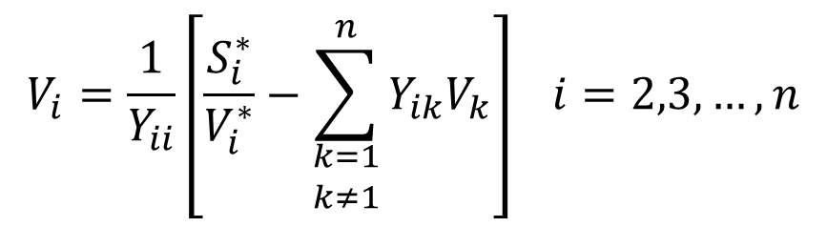
Gauss Iterative Technique
Dividing (27) by $V_{i}^{∗}$ and separating out the $Y_{ii}$ term, (27) can be rewritten as:
or, rearranging:
$$\frac{S_{i}^{∗}}{V_{i}^{∗}}=Y_{ii}V_{i}\sum_{\begin{matrix}k=1 \\ k≠1\end{matrix}}^{n}{Y_{ik}}V_{k} i=2,3,…,n$$
(28)
$$V_{i}=\frac{1}{Y_{ii}}\left[\frac{S_{i}^{∗}}{V_{i}^{∗}}−\sum_{\begin{matrix}k=1 \\ k≠1\end{matrix}}^{n}{Y_{ik}V_{k}}\right] i=2,3,…,n$$
(29)

Slide 23
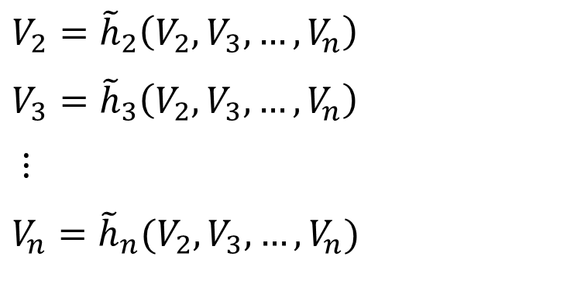
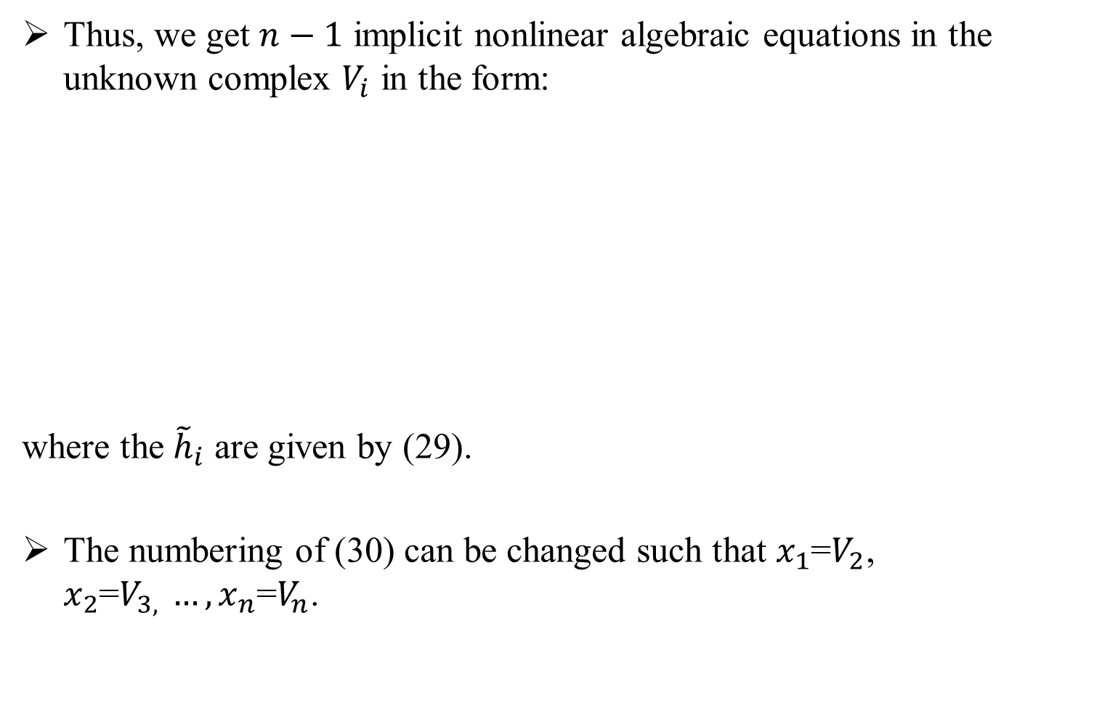
Gauss Iterative Technique
Thus, we get $n−1$ implicit nonlinear algebraic equations in the unknown complex $V_{i}$ in the form:
where the ${\tilde{h}}_{i}$ are given by (29).
The numbering of (30) can be changed such that $x_{1}$=$V_{2}$, $x_{2}$=$V_{3, }…,x_{n}\text{=}V_{n}$.
$$V_{2}={\tilde{h}}_{2}\left(V_{2},V_{3},…,V_{n}\right)$$
$$V_{3}={\tilde{h}}_{3}\left(V_{2},V_{3},…,V_{n}\right)$$
$⋮$
$$V_{n}={\tilde{h}}_{n}(V_{2},V_{3},…,V_{n})$$
(30)

Slide 24
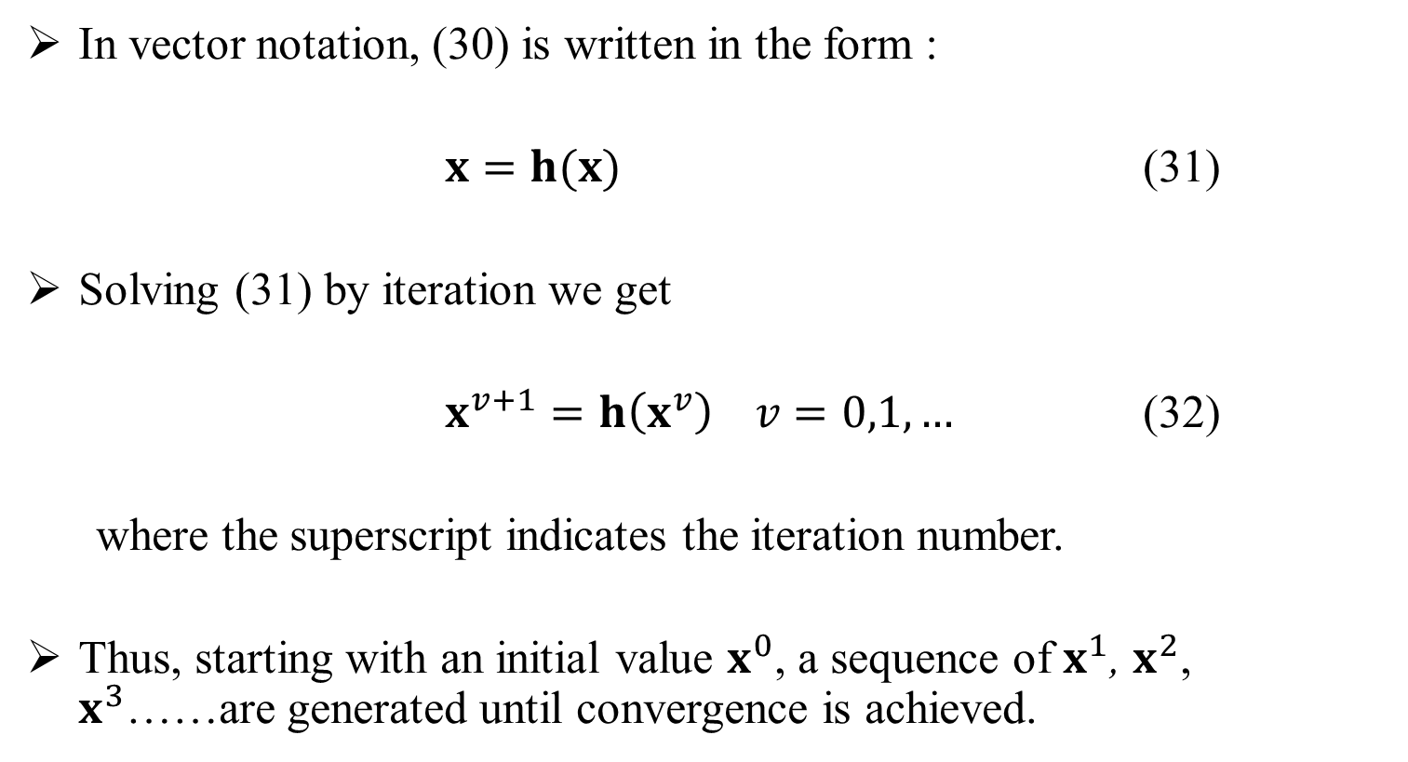
Gauss Iterative Technique
In vector notation, (30) is written in the form :
$x=h(x)$ (31)
Solving (31) by iteration we get
$x^{v+1}=h\left(x^{v}\right) v=0,1,…$ (32)
where the superscript indicates the iteration number.
Thus, starting with an initial value $x^{0}$, a sequence of $x^{1}$, $x^{2}$, $x^{3}$……are generated until convergence is achieved.

Slide 25
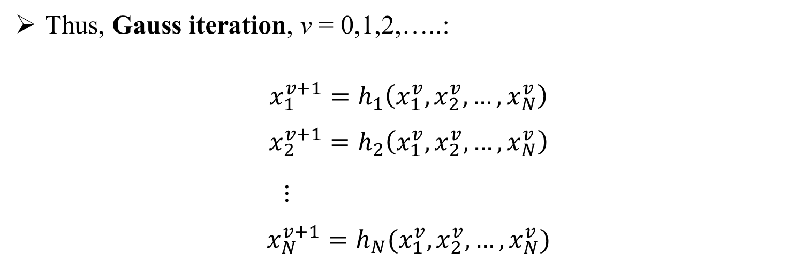
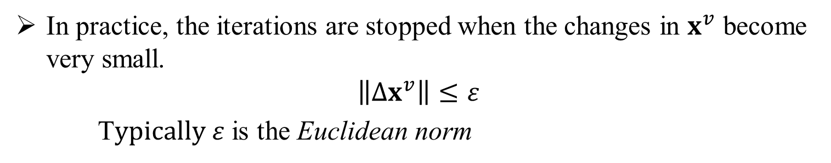
Gauss Iterative Technique
In practice, the iterations are stopped when the changes in $x^{v}$ become very small.
$$\left\|∆x^{v}\right\|≤ε$$
T$ypically ε$ is the Euclidean norm
Thus, Gauss iteration, v = 0,1,2,…..:
$$x_{1}^{v+1}=h_{1}\left(x_{1}^{v},x_{2}^{v},…,x_{N}^{v}\right)$$
$$x_{2}^{v+1}=h_{2}\left(x_{1}^{v},x_{2}^{v},…,x_{N}^{v}\right)$$
$⋮$
$$x_{N}^{v+1}=h_{N}(x_{1}^{v},x_{2}^{v},…,x_{N}^{v})$$
(33)

Slide 26
Part 1 - Review of balanced power flow
Review of balanced power flow
Gauss Iterative Technique
Gauss-Seidel Iterative Technique
Newton Raphson
Fast Decoupled
DC Power Flow

Slide 27
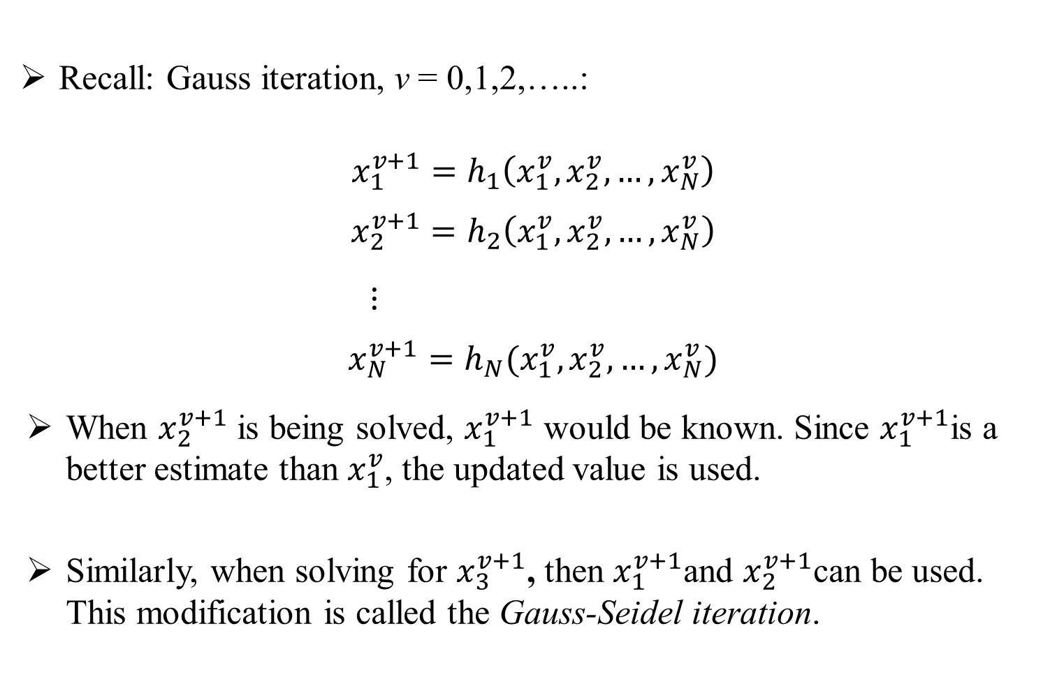
Gauss-Seidel Iterative Technique
Recall: Gauss iteration, v = 0,1,2,…..:
$$x_{1}^{v+1}=h_{1}\left(x_{1}^{v},x_{2}^{v},…,x_{N}^{v}\right)$$
$$x_{2}^{v+1}=h_{2}\left(x_{1}^{v},x_{2}^{v},…,x_{N}^{v}\right)$$
$⋮$
$$x_{N}^{v+1}=h_{N}(x_{1}^{v},x_{2}^{v},…,x_{N}^{v})$$
When $x_{2}^{v+1}$ is being solved, $x_{1}^{v+1}$ would be known. Since $x_{1}^{v+1}$is a better estimate than $x_{1}^{v}$, the updated value is used.
Similarly, when solving for $x_{3}^{v+1}$, then $x_{1}^{v+1}$and $x_{2}^{v+1}$can be used. This modification is called the Gauss-Seidel iteration.
(33)

Slide 28
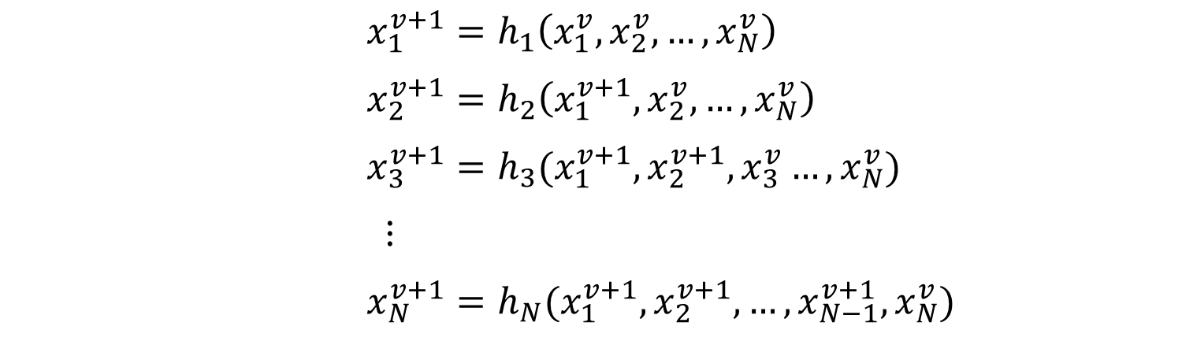
Gauss-Seidel Iterative Technique
Gauss-Seidel iteration, v = 0,1,2,…..:
$x_{1}^{v+1}=h_{1}\left(x_{1}^{v},x_{2}^{v},…,x_{N}^{v}\right)$
$x_{2}^{v+1}=h_{2}\left(x_{1}^{v+1},x_{2}^{v},…,x_{N}^{v}\right)$
$x_{3}^{v+1}=h_{3}(x_{1}^{v+1},x_{2}^{v+1},x_{3}^{v}…,x_{N}^{v})$
$⋮$
$x_{N}^{v+1}=h_{N}(x_{1}^{v+1},x_{2}^{v+1},…,x_{N−1}^{v+1},x_{N}^{v})$
(34)

Slide 29
Part 1 - Review of balanced power flow
Review of balanced power flow
Gauss Iterative Technique
Gauss-Seidel Iterative Technique
Newton Raphson
Fast Decoupled
DC Power Flow

Slide 30
Newton Raphson Method
Newton-Raphson Methods were originally developed for use on transmission level analysis.
They are based on the power injections at each node, both real and reactive.
These power injections are then used to update the voltage and voltage angle.
The NR method is a powerful method of solving a system of non-linear algebraic equations, requiring the calculation and inversion of a Jacobian matrix, which is computationally intensive.
It is faster and converges in most cases.
It is the most widely used method for solving power flow problem.

Slide 31
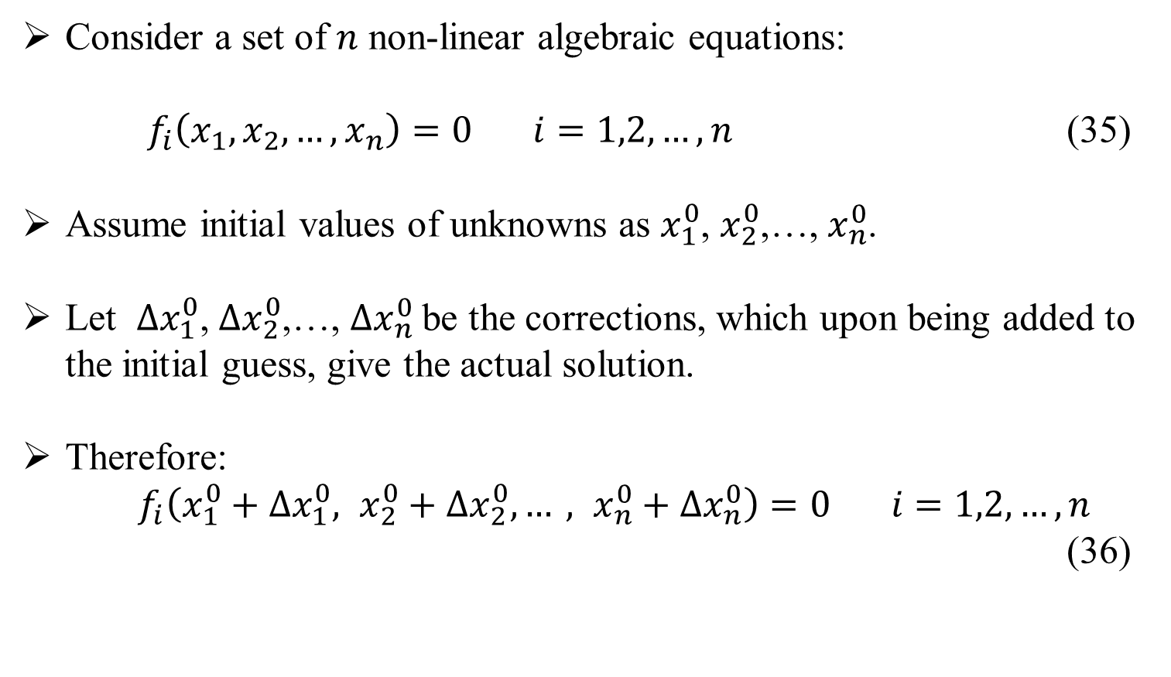
Newton-Raphson Method
The NR method in its general form:
Consider a set of $n$ non-linear algebraic equations:
$f_{i}\left(x_{1},x_{2},…,x_{n}\right)=0 i=1,2,…,n$ (35)
Assume initial values of unknowns as $x_{1}^{0}$, $x_{2}^{0}$,…, $x_{n}^{0}$.
Let ${∆x}_{1}^{0}$, ${∆x}_{2}^{0}$,…, ${∆x}_{n}^{0}$be the corrections, which upon being added to the initial guess, give the actual solution.
Therefore:
$f_{i}\left(x_{1}^{0}+{∆x}_{1}^{0}, x_{2}^{0}+{∆x}_{2}^{0},…, x_{n}^{0}+{∆x}_{n}^{0}\right)=0 i=1,2,…,n$
(36)

Slide 32

Newton-Raphson Method
Expanding these equations in Taylor series around the initial guess gives:
$$f_{i}\left(x_{1}^{0},x_{2}^{0},…,x_{n}^{0}\right)+\left[{\left(\frac{∂f_{i}}{∂x_{1}}\right)}^{0}∆x_{1}^{0}+⋯+{\left(\frac{∂f_{i}}{∂x_{n}}\right)}^{0}∆x_{n}^{0}\right]+higher order terms=0$$
(37)
where ${\left(\frac{∂f_{i}}{∂x_{1}}\right)}^{0}$, ${\left(\frac{∂f_{i}}{∂x_{2}}\right)}^{0},…{\left(\frac{∂f_{i}}{∂x_{n}}\right)}^{0}$are the derivatives of f_{i} with respect to x₁, x₂, …., x_{n} evaluated at $x_{1}^{0},x_{2}^{0},…,x_{n}^{0}$ .

Slide 33
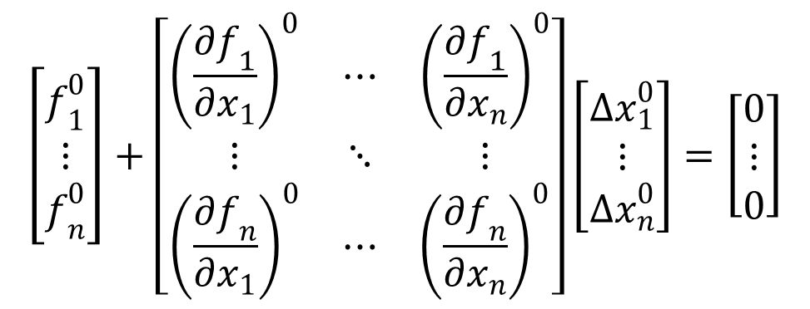
Newton-Raphson Method
Equation 37:
$$f_{i}\left(x_{1}^{0},x_{2}^{0},…,x_{n}^{0}\right)+\left[{\left(\frac{∂f_{i}}{∂x_{1}}\right)}^{0}∆x_{1}^{0}+⋯+{\left(\frac{∂f_{i}}{∂x_{n}}\right)}^{0}∆x_{n}^{0}\right]+higher order terms=0$$
Neglecting higher order terms, write the above Eq. in matrix form.
$$\left[\begin{matrix}f_{1}^{0} \\ ⋮ \\ f_{n}^{0}\end{matrix}\right]+\left[\begin{matrix}{\left(\frac{∂f_{1}}{∂x_{1}}\right)}^{0} & ⋯ & {\left(\frac{∂f_{1}}{∂x_{n}}\right)}^{0} \\ ⋮ & ⋱ & ⋮ \\ {\left(\frac{∂f_{n}}{∂x_{1}}\right)}^{0} & ⋯ & {\left(\frac{∂f_{n}}{∂x_{n}}\right)}^{0}\end{matrix}\right]\left[\begin{matrix}{∆x}_{1}^{0} \\ ⋮ \\ {∆x}_{n}^{0}\end{matrix}\right]=\left[\begin{matrix}0 \\ ⋮ \\ 0\end{matrix}\right]$$
(38)

Slide 34
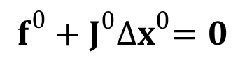

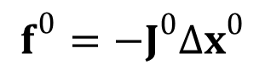
Newton-Raphson Method
Equation 38 can also be expressed as:
$$f^{0}+J^{0}{∆x}^{0}=0$$
(39)
$J^{0}$ is known as the Jacobian matrix (obtained by differentiating the function vector f with respect to x and evaluating it at x⁰)
Equation (39) can be rearranged:
$$f^{0}={−J}^{0}{∆x}^{0}$$
(40)

Slide 35
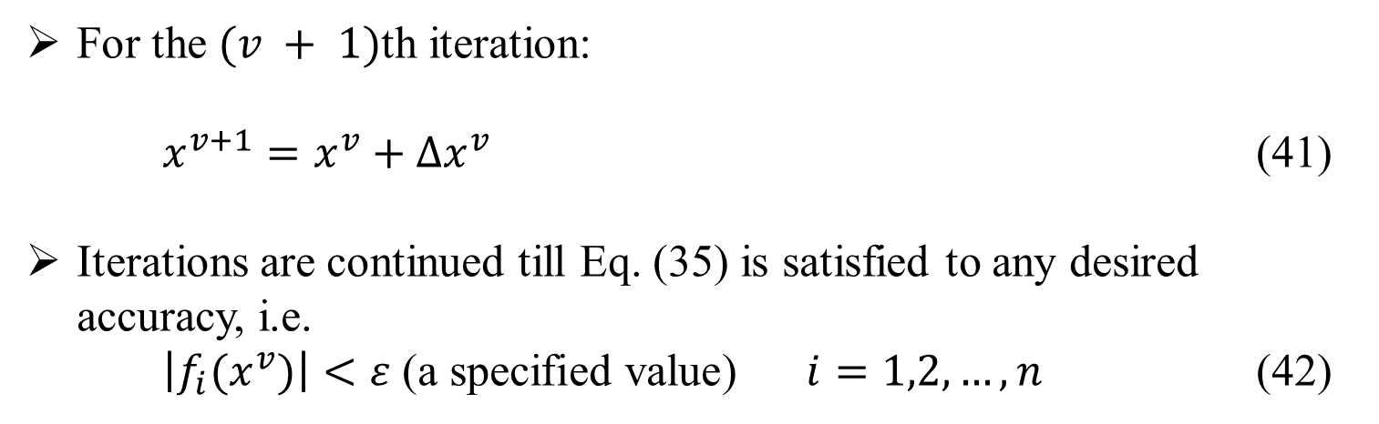
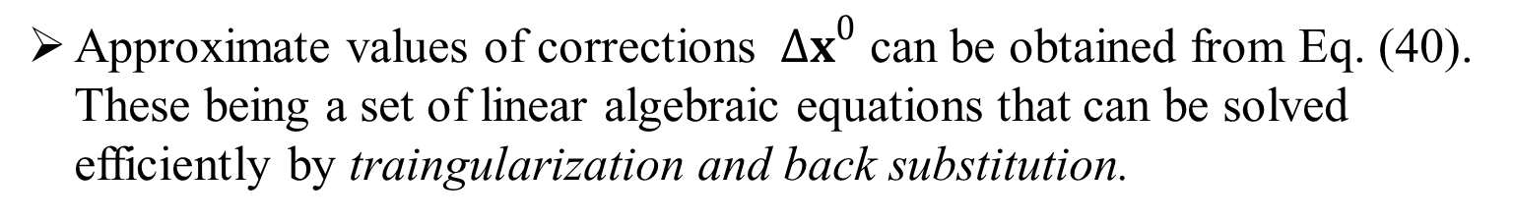
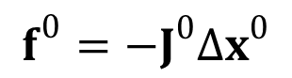
Newton-Raphson Method
$$f^{0}={−J}^{0}{∆x}^{0}$$
Equation 40:
Approximate values of corrections ${∆x}^{0}$ can be obtained from Eq. (40). These being a set of linear algebraic equations that can be solved efficiently by traingularization and back substitution.
For the $(v + 1)$th iteration:
$x^{v+1}=x^{v}+{∆x}^{v}$ (41)
Iterations are continued till Eq. (35) is satisfied to any desired accuracy, i.e.
$\left|f_{i}(x^{v})\right|<ε \text{(}\text{a} \text{specified} \text{value}\text{)}$ $i=1,2,…,n$ (42)

Slide 36
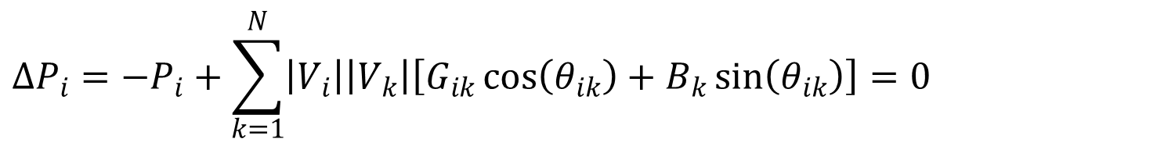
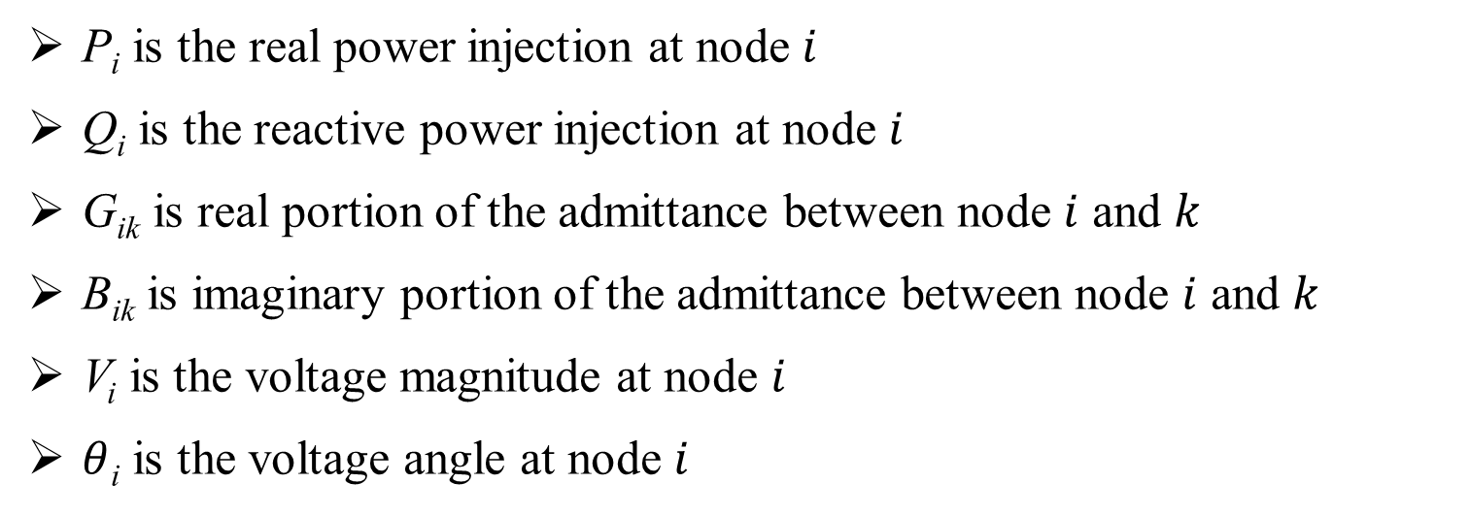
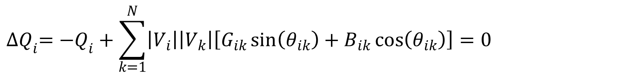
Newton-Raphson Method
Applying to a power system
$$∆P_{i}=−P_{i}+\sum_{k=1}^{N}{\left|V_{i}\right|\left|V_{k}\right|\left[G_{ik}\cos\left(θ_{ik}\right)+B_{k}\sin\left(θ_{ik}\right)\right]}=0$$
(43)
$${∆Q}_{i}=−Q_{i}+\sum_{k=1}^{N}{\left|V_{i}\right|\left|V_{k}\right|\left[G_{ik}\sin\left(θ_{ik}\right)+B_{ik}\cos\left(θ_{ik}\right)\right]=0}$$
P_{i} is the real power injection at node $i$
Q_{i} is the reactive power injection at node $i$
G_{ik} is real portion of the admittance between node $i$ and $k$
B_{ik} is imaginary portion of the admittance between node $i$ and $k$
V_{i} is the voltage magnitude at node $i$
$θ$_{i} is the voltage angle at node $i$

Slide 37
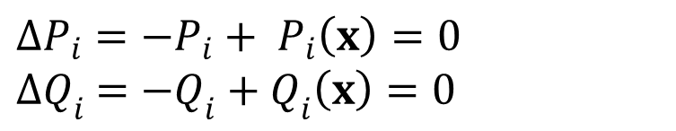
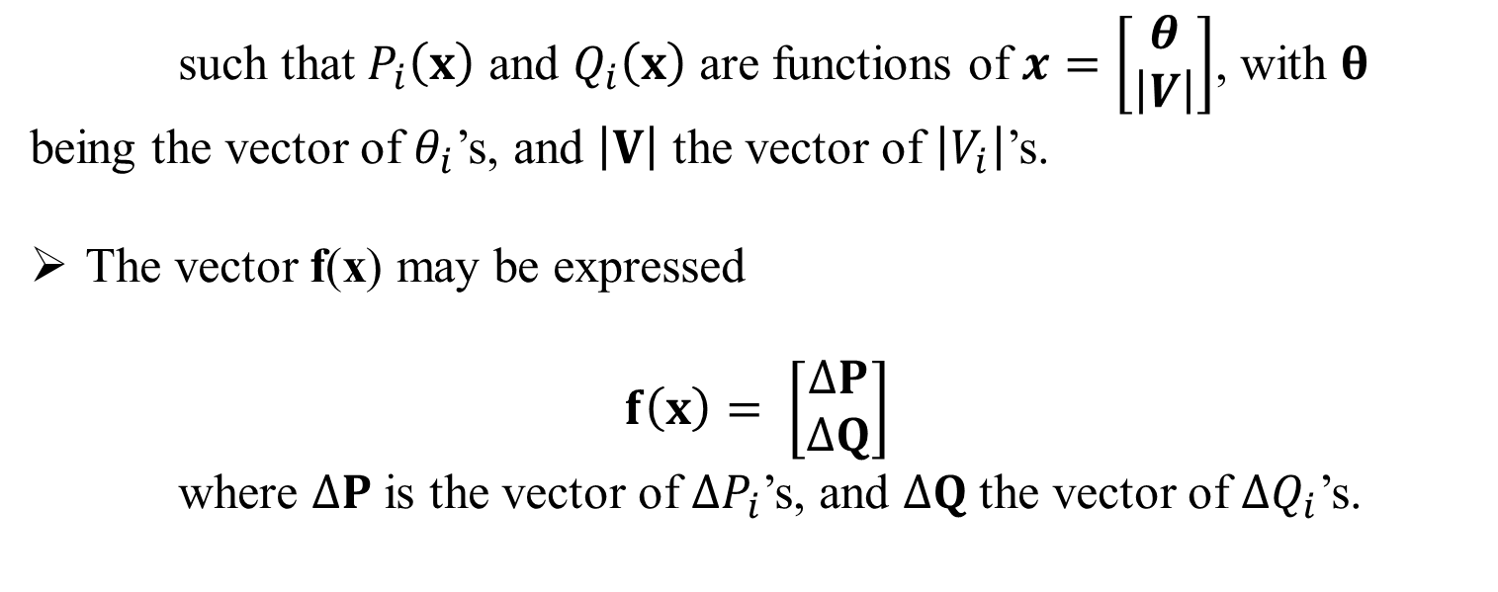
Newton-Raphson Method
Applying to a power system (continued)
Consider Eq’s 43 re-written:
$$∆P_{i}=−P_{i}+ P_{i}\left(x\right)=0$$
$${∆Q}_{i} =−Q_{i}+Q_{i}\left(x\right)=0$$
(44)
such that $P_{i}\left(x\right)$ and $Q_{i}\left(x\right)$ are functions of $x=\left[\begin{matrix}θ \\ \left|V\right|\end{matrix}\right]$, with $θ$ being the vector of $θ_{i}$’s, and $\left|V\right|$ the vector of $\left|V_{i}\right|$’s.
The vector f(x) may be expressed
$$f\left(x\right)= \left[\begin{matrix}∆P \\ ∆Q\end{matrix}\right]$$
where $∆P$ is the vector of $∆P_{i}$’s, and $∆Q$ the vector of ${∆Q}_{i}$’s.

Slide 38

Newton-Raphson Method
Applying to a power system (continued)
Recall Eq. 40:
$f=−J ∆x$.
Thus
$$\left[\begin{matrix}∆P \\ ∆Q\end{matrix}\right]=−J\left[\begin{matrix}∆θ \\ ∆\left|V\right|\end{matrix}\right]$$
$$−J^{−1}\left[\begin{matrix}∆P \\ ∆Q\end{matrix}\right]=\left[\begin{matrix}∆θ \\ ∆\left|V\right|\end{matrix}\right]$$
where the jacobian matrix $J=\left[\begin{matrix}\frac{δ∆P}{δθ} & \frac{δ∆P}{δ\left|V\right|} \\ \frac{δ∆Q}{δθ} & \frac{δ∆Q}{δ\left|V\right|}\end{matrix}\right]$
(45)

Slide 39
Transmission level worked examples
Gauss-Siedel
Newton-Raphson

Slide 40
Gauss-Seidel Iterative Technique
Example A: Gauss-Seidel Power Flow
Figure 5 shows a single-line diagram of a five-bus power system. The four tables on the following slides contain input data.
Figure 5

Slide 41

Table 1: Bus input Data for Example A
Bus | Type | V per unit | $δ$ degrees | $P_{G}$ per unit | $Q_{G}$ per unit | $P_{L}$ per unit | $Q_{L}$ per unit | $Q_{Gmax}$ per unit | $Q_{Gmin}$ per unit
1 | Swing | 1.0 | 0 | - | - | 0 | 0 | - | -
2 | Load | - | - | 0 | 0 | 8 | 2.8 | - | -
3 | Constant Voltage | 1.05 | - | 5.2 | - | .8 | .4 | 4 | -2.8
4 | Load | - | - | 0 | 0 | 0 | 0 | - | -
5 | Load | - | - | 0 | 0 | 0 | 0 | - | -
Bus 1 has a generator connected and is a swing bus.
Bus 3 has a generator and a load connected. It is a voltage controlled bus.
Buses 2,3, and 5 are all load buses.

Slide 42

Table 2: Line input Data for Example A
Bus-to-Bus | R’ per unit | X’ per unit | G’ per unit | B’ per unit | Maximum MVA per unit
2-4 | 0.0090 | 0.100 | 0 | 1.72 | 12.0
2-5 | 0.0045 | 0.050 | 0 | 0.88 | 12.0
4-5 | 0.00225 | 0.025 | 0 | 0.44 | 12.0
Table 3: Transformer input Data for Example A
Bus-to-Bus | R per unit | X per unit | $G_{c}$ per unit | $B_{m}$ per unit | Maximum MVA per unit | Maximum TAP Setting per unit
1-5 | 0.00150 | 0.02 | 0 | 0 | 6.0 | -
3-4 | 0.00075 | 0.01 | 0 | 0 | 10.0 | -

Slide 43


Table 4: Input Data and Unknowns for Example A
Bus | Input Data | Unknowns
1 | $$V_{1}=1.0, δ_{1}=0$$ | $$P_{1},Q_{1}$$
2 | $$P_{2}=P_{G2}−P_{L2}=−8$$ $$Q_{2}=Q_{G2}−Q_{L2}=−2.8$$ | $$V_{2},δ_{2}$$
3 | $$V_{3}=1.05$$ $$P_{3}=P_{G3}−P_{L3}=4.4$$ | $$Q_{3},δ_{3}$$
4 | $$P_{4}=0, Q_{4}=0$$ | $$V_{4},δ_{4}$$
5 | $$P_{5}=0, Q_{5}=0$$ | $$V_{5},δ_{5}$$
Now compute the elements of the second row of $Y_{bus}.$
Since buses 1 and 3 are not directly connected to bus 2,
$Y_{21}=Y_{23}=0$

Slide 44

By using values from Table 2, compute the following.
$Y_{24}=\frac{−1}{R_{24}^{′}+jX_{24}^{′}}=\frac{−1}{0.009+j0.1}$
$=−0.89276+j9.91964=9.95972∠95.143°$ per unit
$Y_{25}=\frac{−1}{R_{25}^{′}+jX_{25}^{′}}=\frac{−1}{0.0045+j0.05}$
$=−1.78552+j19.83932=19.9195∠95.143°$ per unit
$Y_{22}=\frac{1}{R_{24}^{′}+jX_{24}^{′}}+\frac{1}{R_{25}^{′}+jX_{25}^{′}}+j\frac{B_{24}^{′}}{2}+j\frac{B_{25}^{′}}{2}$
$=\left(0.89276−j9.91964\right)+\left(1.78552−j19.83932\right)$
$+j\frac{1.72}{2}+j\frac{0.88}{2}$
$=2.67828−j28.4590=28.5847∠−84.624°$ per unit

Slide 45

Note that half the shunt admittance of each line connected to bus 2 is included in $Y_{22}$, and the other half is at the other end of these lines.
Nodal equations for the power system network may now be written as
$I=Y_{bus}V$.
For each load bus, $I_{k}$ is calculated by
$I_{k}=\frac{P_{k}−jQ_{k}}{V_{k}^{∗}}$.
Applying the Gauss-Seidel power flow method to the nodal equations, with $I_{k}$ as expressed above, gives
$$V_{k}\left(i+1\right)=\frac{1}{Y_{kk}}\left[\frac{P_{k}−{jQ}_{k}}{V_{k}^{∗}(i)}−\sum_{n=1}^{k−1}{Y_{kn}V_{n}\left(i+1\right)}−\sum_{n=k+1}^{N}{Y_{kn}V_{n}(i)}\right]$$
The above equation can be applied twice during each iteration, first using $V_{k}^{∗}(i)$, then replacing that by $V_{k}^{∗}(i+1)$ on the right side.

Slide 46

For a voltage-controlled bus, $Q_{k}$ is unknown, but can be calculated from the following.
$$Q_{k}=V_{k}(i)\sum_{n=1}^{N}{Y_{kn}V_{n}(i)\sin\left[δ_{k}\left(i\right)−δ_{n}\left(i\right)−θ_{kn}\right]}$$
Now, use Gauss-Seidel to calculate the phasor voltage at load bus 2 after the first iteration ($V_{2}(1)$).
$$V_{2}\left(1\right)=\frac{1}{Y_{22}}\left\{\frac{P_{2}−{jQ}_{2}}{V_{2}^{∗}(0)}−\left[Y_{21}V_{1}(1)+Y_{23}V_{3}(0)+Y_{24}V_{4}(0)+Y_{25}V_{5}(0)\right]\right\}$$
$$=\frac{1}{28.5847∠−84.624°}\left\{\frac{−8−j(−2.8)}{1.0∠0°}−\left[\left(−1.78552+j19.83932\right)\left(1.0\right)+\left(−.89276+j9.91964\right)\left(1.0\right)\right]\right\}$$
$=\frac{\left(−8+j2.8\right)−\left(−2.67828+j29.7589\right)}{28.5847∠−84.624°}=0.96132∠−16.543°$ per unit

Slide 47

Now recalculate $V_{2}\left(1\right)$ using $V_{2}^{∗}\left(1\right)$ = $0.96132∠16.543°$ in place of $V_{2}^{∗}(0)$.
$V_{2}\left(1\right)=\frac{1}{28.5847∠−84.624°}\left\{\frac{−8+j2.8}{0.96132∠16.543°}−\left[−2.67828+j29.75829\right]\right\}$
$=\frac{−4.4698−j24.5973}{28.5847∠−84.624°}=0.87460∠−15.675°$ per unit
After performing computations at buses 3, 4, and 5, the first Guess-Seidel iteration will be complete.

Slide 48
Newton-Raphson Example
(Transmission Level Example)

Slide 49
Newton Raphson Procedure
(Example Continued)
(46)
(47)
(48)

Slide 50
Newton Raphson Procedure
(Example Continued)
(49)
(50)

Slide 51
N-R Power Flow Results
(Example Continued)

Slide 52
Part 1 - Review of balanced power flow
Review of balanced power flow
Gauss Iterative Technique
Gauss-Seidel Iterative Technique
Newton Raphson
Fast Decoupled
DC Power Flow

Slide 53

Fast Decoupled Power Flow
As described above, the Jacobian Matrix can be expressed as
$$J=\left[\begin{matrix}\left[\frac{δP}{δθ}\right] & \left[\frac{δP}{δV}\right] \\ \left[\frac{δQ}{δθ}\right] & \left[\frac{δQ}{δV}\right]\end{matrix}\right]$$
The values of the off-diagonal sub-matrices $\left[\frac{δP}{δV}\right]$ and$\left[\frac{δQ}{δθ}\right]$ are small and can be approximated to zero.
Hence, the power flow problem can be decoupled.
(51)

Slide 54

Fast Decoupled Power Flow
Substitute approximations into Eq. (48).
$\left[\begin{matrix}\left[\frac{δP}{δθ}\right] & \left[0\right] \\ \left[0\right] & \left[\frac{δQ}{δV}\right]\end{matrix}\right]\left[\begin{matrix}∆θ \\ ∆V\end{matrix}\right]=\left[\begin{matrix}∆P \\ ∆Q\end{matrix}\right]$
Then,
$$\left[\frac{δP}{δθ}\right]\left[∆θ\right]= \left[∆P\right]$$
$$\left[\frac{δQ}{δV}\right]\left[∆V\right]=\left[∆Q\right]$$
(52)

Slide 55

Fast Decoupled Power Flow
Further assumptions can be made about the terms in $\left[\begin{matrix}δP \\ δθ\end{matrix}\right]$ and $\left[\frac{δQ}{δV}\right]$.
Usually the $G_{ij}$terms of the $Y_{bus}$ are smaller than the $B_{ij}$ and can be ignored.
All per unit bus voltage magnitudes are considered approximately equal and difference between bus angles are considered small.

Slide 56

Fast Decoupled Power Flow
Then, the diagonal terms of $\left[\begin{matrix}δP \\ δθ\end{matrix}\right]$ and $\left[\frac{δQ}{δV}\right]$ can be written as:
$\frac{∂P_{i}}{∂θ_{i}}=−Q_{i}−B_{ii}{\left|V_{i}\right|}^{2}≈\sum_{k=1}^{n}{\left|V_{i}\right|\left|V_{k}\right|B_{ik}−{\left|V_{i}\right|}^{2}B_{ii}≈−{\left|V_{i}\right|}^{2}B_{ii}}$
(53)
$\frac{∂Q_{i}}{∂\left|V_{i}\right|}=\frac{Q_{i}}{\left|V_{i}\right|}−B_{ii}\left|V_{i}\right|≈−\sum_{k=1}^{n}{\left|V_{k}\right|B_{ik}}−\left|V_{i}\right|B_{ii}≈−\left|V_{i}\right|B_{ii}$
(54)

Slide 57

Fast Decoupled Power Flow
The off-diagonal terms of $\left[\begin{matrix}δP \\ δθ\end{matrix}\right]$ and $\left[\frac{δQ}{δV}\right]$ can be written as:
$\frac{∂P_{i}}{∂θ_{j}}=\left|V_{i}\right|\left|V_{j}\right|\left(G_{ij}\sin{θ_{ij}−B_{ij}\cos{θ_{ij}}}\right)≈−\left|V_{i}\right|\left|V_{j}\right|B_{ij}$
$\frac{∂Q_{i}}{∂\left|V_{j}\right|}=\left|V_{i}\right|\left(G_{ij}\sin{θ_{ij}−B_{ij}\cos{θ_{ij}}}\right)≈−\left|V_{i}\right|B_{ij}$
(55)

Slide 58

Fast Decoupled Power Flow
Consider $\left[V\right]≜\left[\begin{matrix}\left|V_{2}\right| & ⋯ & 0 \\ ⋮ & ⋱ & ⋮ \\ 0 & ⋯ & \left|V_{n}\right|\end{matrix}\right]$ and $B≜\left[\begin{matrix}B_{22} \\ ⋮ \\ B_{n2}\end{matrix} \begin{matrix}B_{23} \\ ⋮ \\ B_{n3}\end{matrix} ⋯ \begin{matrix}B_{2n} \\ ⋮ \\ B_{nn}\end{matrix}\right]$,
where B may obtained from $Y_{bus}$ by stripping away the first row and column and then taking the imaginary part.
Then,
$$\left[\begin{matrix}δP \\ δθ\end{matrix}\right]=−\left[V\right]B\left[V\right]$$
$$\left[\frac{δQ}{δV}\right]=−\left[V\right]B$$
(56)

Slide 59

Fast Decoupled Power Flow
Substitute into Eq. 52 to get:
$$−\left[V\right]B\left[V\right]\left[∆θ\right]= \left[∆P\right]$$
$$−\left[V\right]B\left[∆V\right]=\left[∆Q\right]$$
Because of the assumption that all per unit $\left|V_{i}\right|$ are equal, assume the second $\left[V\right]$ in (57) is the identity matrix.
Thus
$$−B\left[∆θ\right]={\left[V\right]}^{−1}\left[∆P\right]=\left[∆\tilde{P}\right]$$
$−B\left[∆V\right]={\left[V\right]}^{−1}\left[∆Q\right]=\left[∆\tilde{Q}\right]$
Note that $\left[∆\tilde{P}\right]$ and $\left[∆\tilde{Q}\right]$ are just scaled versions of $\left[∆P\right]$ and $\left[∆Q\right]$.
(57)
(58)

Slide 60
Fast Decoupled Power Flow
An important observation is that B is a constant matrix, independent of iteration count. Thus, only one matrix inversion of B is required.
These equations are known as the fast-decoupled power flow equations and this is most commonly used as the power flow solver in commercial packages.

Slide 61
Part 1 - Review of balanced power flow
Review of balanced power flow
Gauss Iterative Technique
Gauss-Seidel Iterative Technique
Newton Raphson
Fast Decoupled
DC Power Flow

Slide 62

DC Power Flow
If from the above the reactive power flow equations are completely ignored and all voltages are assumed at 1p.u., the power flow solution becomes a linear, convergent set of real power equation of the form
$θ=B^{−1}$P
The name DC Power Flow is derived from the fact that the equations are linear and the solution of the equations is real power.
DC Power Flow is used in OPF solvers, LMP solvers and Contingency analysis.

Slide 63
Part 2 - Forward Backward Sweep (FBS) method
If the distribution feeders are mainly radial (which is true in most cases), the iterative techniques discussed above for transmission networks show poor convergence characteristics.
Instead, an iterative technique called Forward Backward Sweep is used for radial distribution systems.
Consider Figure 7 as shown in the next slide. It is a nonlinear system with constant complex power loads.

Slide 64
Part 2 - Forward Backward Sweep (FBS) method
Figure 7: Nonlinear Ladder Network
The ‘Forward’ sweep computes the voltage at node 5 under no-load condition.
With no load currents, there are no line currents.
Thus the node 5 voltage will equal that of the specified source voltage.
The ‘Backward’ sweep commences by computing the load current at node 5.

Slide 65

Part 2 - Forward Backward Sweep (FBS) method
In general, the load current at each node is computed by:
$I_{n}={\left(\frac{S_{n}}{V_{n}}\right)}^{∗}$ (59)
The backward sweep will determine a computed source voltage $V_{1}$.
However, the first iteration will produce a voltage that is not equal to the specified source voltage $V_{s}$.
Because the system is non-linear, the solution must be found by again doing an iteration of the ‘Forward’ sweep.

Slide 66

Part 2 - Forward Backward Sweep (FBS) method
The ‘Forward’ sweep is conducted with the specified source voltage and the line currents from the previous backward sweep.
Using KVL at node 2 gives:
$V_{2}=V_{s}−Z_{12}∙I_{12}$ (60)
This procedure is repeated for each line segment until a “new” voltage is determined at node 5.
Using the new voltage a backward sweep is started that will lead to a new computed voltage at the source.

Slide 67



Part 2 - Forward Backward Sweep (FBS) method
The forward and backward sweep process is continued until the difference between the computed and specified voltage at the source is within a given tolerance.
Example
Figure 8 shows a single-phase lateral with line impedance $z=0.3+j0.6$ Ω/mile.
The impedance of Segment 1-2 is
$Z_{12}=\left(0.3+j0.6\right)∙\frac{3000}{5280}=0.1705+j0.3409$ Ω.
Figure 8
The impedance of Segment 2-3 is
$Z_{23}=\left(0.3+j0.6\right)∙\frac{4000}{5280}=0.2273+j0.4545$ Ω.

Slide 68

Part 2 - Forward Backward Sweep (FBS) method
Example (Continued)
The loads are: $S_{2}=1500+j750$
(kW + j kVAr)
$S_{3}=900+j500$
The source voltage at node 1 is 7,200 volts.
The first forward sweep computes node 3 voltage as:
$V_{2}=V_{s}−Z_{12}∙0=7200∠0$
$V_{3}=V_{2}−Z_{23}∙0=7200∠0$
The backward sweeps starts by computing load current at node 3:
$I_{3}={\left(\frac{\left(900+j500\right)∙1000}{7200∠0}\right)}^{∗}=143.0∠−29.0$ A

Slide 69

Part 2 - Forward Backward Sweep (FBS) method
Example (Continued)
The current flowing in Section 2-3 is $I_{23}=I_{3}=$ $143.0∠−29.0$ A.
Then the voltage at node 2 is computed:
$V_{2}=V_{3}+Z_{23}∙I_{23}$
$=7200∠0+\left(0.2273+j0.4545\right)∙143.0∠−29.1$
$=7260.1∠0.32$ V
The load current at node 2 is:
$I_{2}={\left(\frac{\left(1500+j750\right)∙1000}{7260.1∠0.32}\right)}^{∗}=231.0∠−26.3$ A
The current in segment 1-2 is $I_{12}=I_{23}+I_{2}=373.9∠−27.3$ A
The voltage at source node 1 is computed:
$V_{1}=V_{2}+Z_{12}∙I_{12}=7376.2∠0.97$ V

Slide 70

Part 2 - Forward Backward Sweep (FBS) method
Example (Continued)
Now compare the magnitude of computed node 1 voltage to the magnitude of specified source voltage.
$Error= \left|\left|V_{s}\right|−\left|V_{1}\right|\right|=176.2$ V
If error is less than specified tolerance, solution is achieved.
Typical error tolerance is .0001 per-unit, thus for 7200 V is 7.2 V.
Because 176.2 $>$ 7.2, forward sweep begins by setting voltage at node 1 to specified source voltage: $V_{1}=V_{s}=7200∠0$ V.

Slide 71

Part 2 - Forward Backward Sweep (FBS) method
Example (Continued)
Now compute voltage at node 2 using value of node 1 voltage and computed line current from previous backward sweep.
$V_{2}=V_{1}−Z_{12}∙I_{12}$
$=7200∠0−\left(0.1705+j0.3409\right)∙373.9∠−27.2$
$=7085.4∠−0.68$ V
Continue the Forward sweep by computing the next downstream voltage. Currents computed in previous backward sweep are used in forward sweep.
$V_{3}=V_{2}−Z_{23}∙I_{23}=7026.0∠−1.02$ V
Now repeat backward sweep starting with newly computed voltage at node 3.

Slide 72
Part 2 - Forward Backward Sweep (FBS) method
General Feeder
For a general feeder like the one shown in Figure 9, the following methodology is adopted.
For the forward sweep, using the specified voltage at node 1, compute the voltages at the “end” nodes (6, 8, 9, 11 and13)
Figure 9
The backward sweep is first conducted from the “end” nodes to the “junction” nodes. “Junction” nodes in this case would be node 10 for nodes 11, 12; node 7 for nodes 8 and 9; node 5 for nodes 7 and 6 and finally node 4 for nodes 10, 5 and 7.

Slide 73
Part 2 - Forward Backward Sweep (FBS) method
General Feeder (Continued)
The downstream “junction” node voltages are first calculated before moving to the upstream “junction” nodes. For example, in this case, voltage at node 7 is calculated before node 5; node 10 voltage is calculated before calculating voltage at node 4.
The backward sweep is completed with the calculation of the voltage at node 1 and compared with the specified source voltage.
If the comparison is not within tolerance, a forward sweep is again conducted using new upstream voltages and the current from the previous backward sweep.

Slide 74
Part 2 - Forward Backward Sweep (FBS) method
General Feeder (Continued)
The forward sweep is completed when new end voltages are found.
A backward sweep is started with the new end voltages.
Continue the forward and backward sweeps until the calculated voltage at the source is within the specified tolerance of the source voltage.
Thus all the node voltages and line currents are obtained in this way.

Slide 75
Part 2 - Forward Backward Sweep (FBS) method
For the unbalanced feeder analysis, as shown in Figure 10, the feeder can be broken into “series” and “shunt” components.
Series Components will be Line Segments, Transformers and Voltage Regulators.
Shunt components will be Spot static loads, Spot induction machines, Distributed Loads and Capacitor Banks.
Using the generalized matrices, the voltage drops can be computed.
Figure 10

Slide 76
Part 2 - Forward Backward Sweep (FBS) method
It is extremely important that the impedances and admittances of the line segments are computed using the exact spacing and phasing.
Because of the unbalanced loading and resulting unbalanced line currents, the voltage drops due to the mutual coupling of the lines becomes very important.

Slide 77
Part 2 - Forward Backward Sweep (FBS) method
An unbalanced feeder example

Slide 78
Part 2 - Forward Backward Sweep (FBS) method
Starting with an assumed or known voltage calculate the current consumed by each load in the system.
Node 634 load: Phase a: 160 kW 110 kVar
Phase b: 120 kW 90 kVar
Phase c: 120 kW 90 kVar
Assume: Phase V_{a}: 2401+0j
Phase V_{b}: -1200-2080j
Phase V_{c}: -1200+2080j
Given: I=(S/V)*
Yields: I_{a}= 66.6-45.8j
I_{b}= -57.4-24.6j
I_{c}= 7.5+62.0j

Slide 79

Part 2 - Forward Backward Sweep (FBS) method
Sum the currents at each node in the system until the current at the source is determined.
I_{a}= 66.6-45.8j
I_{b}= -57.4-24.6j
I_{c}= 7.5+62.0j

Slide 80

Part 2 - Forward Backward Sweep (FBS) method
Using the calculated currents determine the voltage drops on each segment.
Since the voltage drop is dependent on the load of the other phases a complete per phase calculation must be used.

Slide 81
Part 2 - Forward Backward Sweep (FBS) method
Using the calculated currents determine the voltage drops on each segment.
Since the voltage drop is dependent on the load of the other phases a complete per phase calculation must be used.
Based on the new voltages recalculate the new current draw of each load and perform another sweep.

Slide 82
Part 3 - Three Phase Current Injection (TCIM) Newton Raphson (NR) method
This method uses power flow formulations based on current injections.
The current injections are written in rectangular coordinates.
The set of nonlinear equations that results is solved using the Newton Raphson method.

Slide 83

Part 3 - Three Phase Current Injection (TCIM) Newton Raphson (NR) method
Three phase current mismatches for bus $k=\{1,…,n\}$ are:
$∆I_{k}^{s}=\frac{{\left(P_{k}^{sp}\right)}^{s}−j{\left(Q_{k}^{sp}\right)}^{s}}{{\left(E_{k}^{s}\right)}^{∗}}−\sum_{i∈Ω_{k}}{\sum_{t∈α_{p}}{Y_{ki}^{st}E_{i}^{t}}}$
where $α_{p}=\left\{a,b,c\right\}$
$s,t∈α_{p}$
$Ω_{k}=\left\{i \right|$ Bus $i$ is directly connected to bus $k \}$
$E_{k}=V_{r_{k}}+jV_{m_{k}}$
$Y_{ki}^{st}=G_{ki}^{st}+jB_{ki}^{st}$ is the nodal admittance bus matrix element.
(61)

Slide 84

Part 3 - Three Phase Current Injection (TCIM) Newton Raphson (NR) method
The specified active and reactive powers at bus $k$ for phase $s$ are: ${\left(P_{k}^{sp}\right)}^{s}=P_{g_{k}}^{s}−P_{l_{k}}^{s}$
${\left(Q_{k}^{sp}\right)}^{s}=Q_{g_{k}}^{s}−Q_{l_{k}}^{s}$
where $P_{g_{k}}^{s}$, $P_{l_{k}}^{s}$, $Q_{g_{k}}^{s}$, $Q_{l_{k}}^{s}$ are the active and reactive powers, respectively, of generators and loads.
The effect of voltage level on system loads is represented by second order polynomial equations, as follows:
$$P_{l_{k}}^{s}=P_{0_{k}}^{s}+P_{1_{k}}^{s}V_{k}+P_{2_{k}}^{s}V_{k}^{2}$$
$$Q_{l_{k}}^{s}=Q_{0_{k}}^{s}+Q_{1_{k}}^{s}V_{k}+Q_{2_{k}}^{s}V_{k}^{2}$$
where $P_{0_{k}}^{s}$, $Q_{0_{k}}^{s}$ are constant power components, $P_{1_{k}}^{s}$, $Q_{1_{k}}^{s}$ are constant current components, $P_{2_{k}}^{s}$, $Q_{2_{k}}^{s}$ are constant impedance components of phase $s$ load at bus $k$, and $V_{k}=\left|E_{k}\right|$.
(62)
(63)

Slide 85

Part 3 - Three Phase Current Injection (TCIM) Newton Raphson (NR) method
Express Eq. (61) in terms of its real and imaginary parts:
$$∆I_{r_{k}}^{s}=\frac{{\left(P_{k}^{sp}\right)}^{s}V_{r_{k}}^{s}+{\left(Q_{k}^{sp}\right)}^{s}V_{m_{k}}^{s}}{{\left(V_{r_{k}}^{s}\right)}^{2}+{\left(V_{m_{k}}^{s}\right)}^{2}}−\sum_{i=1}^{n}{\sum_{t∈α_{p}}{\left(G_{ki}^{st}V_{r_{i}}^{t}−B_{ki}^{st}V_{m_{i}}^{t}\right)}}$$
$$∆I_{m_{k}}^{s}=\frac{{\left(P_{k}^{sp}\right)}^{s}V_{m_{k}}^{s}+{\left(Q_{k}^{sp}\right)}^{s}V_{r_{k}}^{s}}{{\left(V_{r_{k}}^{s}\right)}^{2}+{\left(V_{m_{k}}^{s}\right)}^{2}}−\sum_{i=1}^{n}{\sum_{t∈α_{p}}{\left(G_{ki}^{st}V_{m_{i}}^{t}−B_{ki}^{st}V_{r_{i}}^{t}\right)}}$$
(64)
(65)

Slide 86

Part 3 - Three Phase Current Injection (TCIM) Newton Raphson (NR) method
Apply Newton’s method to (64) and (65).
$$\left[\begin{matrix}∆I_{m_{k}}^{abc} \\ {∆I}_{r_{k}}^{abc}\end{matrix}\right]=J\left[\begin{matrix}{∆V}_{r_{k}}^{abc} \\ ∆V_{m_{k}}^{abc}\end{matrix}\right]$$
where $J=\left[\begin{matrix}\frac{δ∆I_{m_{k}}^{abc}}{δV_{r_{k}}^{abc}} & \frac{δ∆I_{m_{k}}^{abc}}{δV_{m_{k}}^{abc}} \\ \frac{δ∆I_{r_{k}}^{abc}}{δV_{r_{k}}^{abc}} & \frac{δ∆I_{r_{k}}^{abc}}{δV_{m_{k}}^{abc}}\end{matrix}\right]$.
The off-diagonal elements are identical to the corresponding elements of the bus admittance matrix.
(66)

Slide 87

Part 3 - Three Phase Current Injection (TCIM) Newton Raphson (NR) method
The current mismatch of (66) for bus $k$ and phase $s$ can be expressed:
$$∆I_{r_{k}}^{s}=\frac{V_{r_{k}}^{s}{∆P}_{k}^{s} + V_{m_{k}}^{s}{∆Q}_{k}^{s}}{{\left(V_{r_{k}}^{s}\right)}^{2}+ {\left(V_{m_{k}}^{s}\right)}^{2}}$$
$$∆I_{m_{k}}^{s}=\frac{V_{m_{k}}^{s}{∆P}_{k}^{s} + V_{r_{k}}^{s}{∆Q}_{k}^{s}}{{\left(V_{r_{k}}^{s}\right)}^{2}+ {\left(V_{m_{k}}^{s}\right)}^{2}}$$
(67)

Slide 88

Part 3 - Three Phase Current Injection (TCIM) Newton Raphson (NR) method
where active and reactive power mismatches given by:
$${∆P}_{k}^{s}={\left({∆P}_{k}^{sp}\right)}^{s}−{\left({∆P}_{k}^{calc}\right)}^{s}$$
$${∆Q}_{k}^{s}={\left({∆Q}_{k}^{sp}\right)}^{s}−{\left({∆Q}_{k}^{calc}\right)}^{s}$$
where
$${\left({∆P}_{k}^{calc}\right)}^{s}=V_{r_{k}}^{s}{\left(I_{r_{k}}^{calc}\right)}^{s}+V_{m_{k}}^{s}{\left(I_{m_{k}}^{calc}\right)}^{s}$$
$${\left({∆Q}_{k}^{calc}\right)}^{s}=V_{m_{k}}^{s}{\left(I_{r_{k}}^{calc}\right)}^{s}+V_{r_{k}}^{s}{\left(I_{m_{k}}^{calc}\right)}^{s}$$
(68)
(69)

Slide 89

Part 3 - Three Phase Current Injection (TCIM) Newton Raphson (NR) method
The system of linear equations in (66) are solved for the voltage increments using sparse matrix techniques using the Tinney-2 ordering scheme.
At each iteration, the voltages are updated.
$${\left(V_{{rm}_{k}}^{abc}\right)}^{h+1}= {\left(V_{{rm}_{k}}^{abc}\right)}^{h}+{\left(∆V_{{rm}_{k}}^{abc}\right)}^{h}$$
where
$$V_{{rm}_{k}}^{abc}={\left[V_{r_{k}}^{a} V_{r_{k}}^{b} V_{r_{k}}^{c} V_{m_{k}}^{a} V_{m_{k}}^{b} V_{m_{k}}^{c}\right]}^{t}$$
(70)

Slide 90

Part 3 - Three Phase Current Injection (TCIM) Newton Raphson (NR) method
Representing PV Buses
Assume a PV bus $k$ is directly connected to buses $i$ and $l$.
Then Eq (66) can be expressed:
$$\left[\begin{matrix}\begin{matrix}∆I_{m_{1}}^{abc} \\ ∆I_{r_{1}}^{abc}\end{matrix} \\ ⋮ \\ \begin{matrix}\begin{matrix}∆I_{m_{i}}^{abc} \\ ∆I_{r_{i}}^{abc}\end{matrix} \\ ⋮ \\ \begin{matrix}\begin{matrix}∆I_{m_{k}}^{abc} \\ ∆I_{r_{k}}^{abc}\end{matrix} \\ \begin{matrix}⋮ \\ ∆I_{m_{l}}^{abc} \\ \begin{matrix}∆I_{r_{l}}^{abc} \\ ⋮\end{matrix}\end{matrix}\end{matrix}\end{matrix}\end{matrix}\right]=\left[\begin{matrix}Y_{11}^{abc} ⋯ \\ ⋮ \\ \begin{matrix}Y_{i1}^{abc} ⋯ \\ ⋮ \\ \begin{matrix}Y_{k1}^{abc} ⋯ \\ \begin{matrix}⋮ \\ Y_{l1}^{abc} ⋯ \\ ⋮\end{matrix}\end{matrix}\end{matrix}\end{matrix} \begin{matrix}Y_{1i}^{abc} ⋯ \\ ⋮ \\ \begin{matrix}Y_{ii}^{abc} ⋯ \\ ⋮ \\ \begin{matrix}Y_{ki}^{abc} ⋯ \\ \begin{matrix}⋮ \\ Y_{li}^{abc} ⋯ \\ ⋮\end{matrix}\end{matrix}\end{matrix}\end{matrix} \begin{matrix}Y_{1k}^{abc} ⋯ \\ ⋮ \\ \begin{matrix}Y_{ik}^{abc} ⋯ \\ ⋮ \\ \begin{matrix}Y_{kk}^{abc} ⋯ \\ \begin{matrix}⋮ \\ Y_{lk}^{abc} ⋯ \\ ⋮\end{matrix}\end{matrix}\end{matrix}\end{matrix} \begin{matrix}Y_{1l}^{abc} ⋯ \\ ⋮ \\ \begin{matrix}Y_{il}^{abc} ⋯ \\ ⋮ \\ \begin{matrix}Y_{kl}^{abc} ⋯ \\ \begin{matrix}⋮ \\ Y_{ll}^{abc} ⋯ \\ ⋮\end{matrix}\end{matrix}\end{matrix}\end{matrix}\right]\left[\begin{matrix}\begin{matrix}∆V_{r_{1}}^{abc} \\ ∆V_{m_{1}}^{abc}\end{matrix} \\ ⋮ \\ \begin{matrix}\begin{matrix}∆V_{r_{i}}^{abc} \\ ∆V_{m_{i}}^{abc}\end{matrix} \\ ⋮ \\ \begin{matrix}\begin{matrix}∆V_{m_{k}}^{abc} \\ ∆Q_{k}^{abc}\end{matrix} \\ \begin{matrix}⋮ \\ ∆V_{r_{l}}^{abc} \\ \begin{matrix}∆V_{m_{l}}^{abc} \\ ⋮\end{matrix}\end{matrix}\end{matrix}\end{matrix}\end{matrix}\right]$$
(71)

Slide 91

Part 3 - Three Phase Current Injection (TCIM) Newton Raphson (NR) method
Where each $Y_{im}^{abc}$ ;$i,m∈\{1,…,n\}$ is a 6x6 sub-matrix.
Since both the diagonal and off-diagonal elements of column $k$ of (71) are functions of real and imaginary voltages, the Jacobian matrix will have to be updated at every iteration.
Three-phase current mismatches at bus $k$ are given by:
${\left({∆I}_{m_{k}}^{•}\right)}^{abc}$=${\left[\frac{V_{m_{k}}^{a}{∆P}_{k}^{a}}{{\left(V_{k}^{a}\right)}^{2}} \frac{V_{m_{k}}^{b}{∆P}_{k}^{b}}{{\left(V_{k}^{b}\right)}^{2}} \frac{V_{m_{k}}^{c}{∆P}_{k}^{c}}{{\left(V_{k}^{c}\right)}^{2}}\right]}^{t}$
${\left({∆I}_{r_{k}}^{•}\right)}^{abc}$=${\left[\frac{V_{r_{k}}^{a}{∆P}_{k}^{a}}{{\left(V_{k}^{a}\right)}^{2}} \frac{V_{r_{k}}^{b}{∆P}_{k}^{b}}{{\left(V_{k}^{b}\right)}^{2}} \frac{V_{r_{k}}^{c}{∆P}_{k}^{c}}{{\left(V_{k}^{c}\right)}^{2}}\right]}^{t}$
(72)

Slide 92

Part 3 - Three Phase Current Injection (TCIM) Newton Raphson (NR) method
Powerful feature of TCIM comes from the fact that the Jacobian matrix has partitions that are identical to the bus admittance matrix.
Algorithm:
Initialize the iteration count and set voltages to initial value.
Compute three-phase active and reactive power injections (Eq’s 69).
Compute power mismatches (Eq’s 68).
Test for convergence: if max$\left\{\left|{\left(∆P_{k}^{s}\right)}^{\left(h\right)}\right|\right\}≤ε_{p}$ and max$\left\{\left|{\left(∆Q_{k}^{s}\right)}^{\left(h\right)}\right|\right\}≤ε_{q}$ then finish, else go to next step.
Compute Jacobian matrix.
Solve (71) for voltage increments.
Update voltages (70), then go to Step 2.

Slide 93
Sources
[1]Vyakaranam, B. Chapter 6: Power Flows [PowerPoint Slides] for EEC 473/571 Power Systems, Cleveland State University, Department of Electrical and Computer Engineering. 2009.
[2] Bergen, A.R.; Vittal V. Power Systems Analysis, Second Edition. Upper Saddle River (NJ): Prentice-Hall, Inc; 2000. 619p.
[3] Kersting, W.H., Distribution System Modeling and Analysis. Boca Raton: CRC Press; 2002. 314p.
[4] Garcia, P.A.N.; Pereira, J.L.R.; Carneiro, S., Jr.; da Costa, V.M.; Martins, N.; , "Three-phase power flow calculations using the current injection method," Power Systems, IEEE Transactions on , vol.15, no.2, pp.508-514, May 2000 [5] “Book with Gauss-Seidel Power flow example”
[6] “Newton Raphson Example”

Slide 94
Module 3 Concluding Comments
1
2
3
4

